Slide 1

Test Launch Customer Survey Results
Our team has conducted a survey for the 50 customers that participate in the test launch to understand the overall experience of the pilot service and collect digital feedback from them.

Slide 2
Summary
As we collected the digital feedback and analysis it. Our team discover we have reaches some of our goals and milestones which are mentioned below:
Fully Achieved
Achieved the goal of increase the sale of appetizers, dinner and drinks through new tablet service.
Achieve the target of customer experience with tablet i.e., 86% which is above the expected one.
Around 3/4 customer checked for the newsletter.
Achieved the target of decrease the table run time by 30 minutes.
Achieved the milestone of fully trained the staff about new service.
Launch the Test pilot service in North and downtown restaurants at full potential.
Achieved the milestone of good relations with vendors with help us in future projects or improvements in restaurants.
Partial Achieved
Ease-of-Use tablet is partially achieved as more than 45% customer feel neutral or difficult to use it.
Technical issue are less around 12% which is less than 15% as expected by us.
Digital menu, it’s design and layout, Graphics and pictures are well as 76% customer like and find easy to order from the tablet which is above than expectation but below the restaurants standards.
76% customers understand the instruction very well which is achieved but still below the restaurant ORKs.

Slide 3
Overview
As our team wanted measure some response with respect to Evaluation indicators and questions. We compare it and find the overall success we achieved.
Ease-To-Use software design, layout, etc. - As 76% customer find easy to order directly with tablet.
Table Turn Time - As 56% customers still wait for more than 15 minute, here we have to do more work.
Reduce food waiting time - As 86% customers have to wait less than an hour which is great push to our boundaries.
Correctly prepared Food - As 28% customers still received un-prepared food, we have to increase the kitchen strength.
Staff's Feedback - As 100% employees gives their buy-ins for the pilot service.
Customers Experience - As the 72% customers like the tablet service, out of 40% customers want use exclusively and 30% customers preferred mix of tablet and waiter.
Customer Satisfaction - As per the survey reports, ¾ of the them feel satisfied with the overall experience of blended service i.e., Use of technology and manpower.

Slide 4
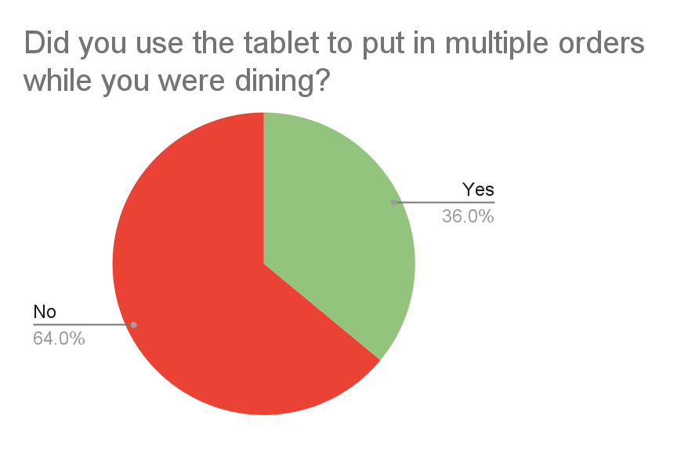
Findings
As we see in this pie chart, around 64% customers didn’t use tablets for multiple orders.
This means the customer prefer to initial order with the tablet and the interact with waiter as more orders.

Slide 5
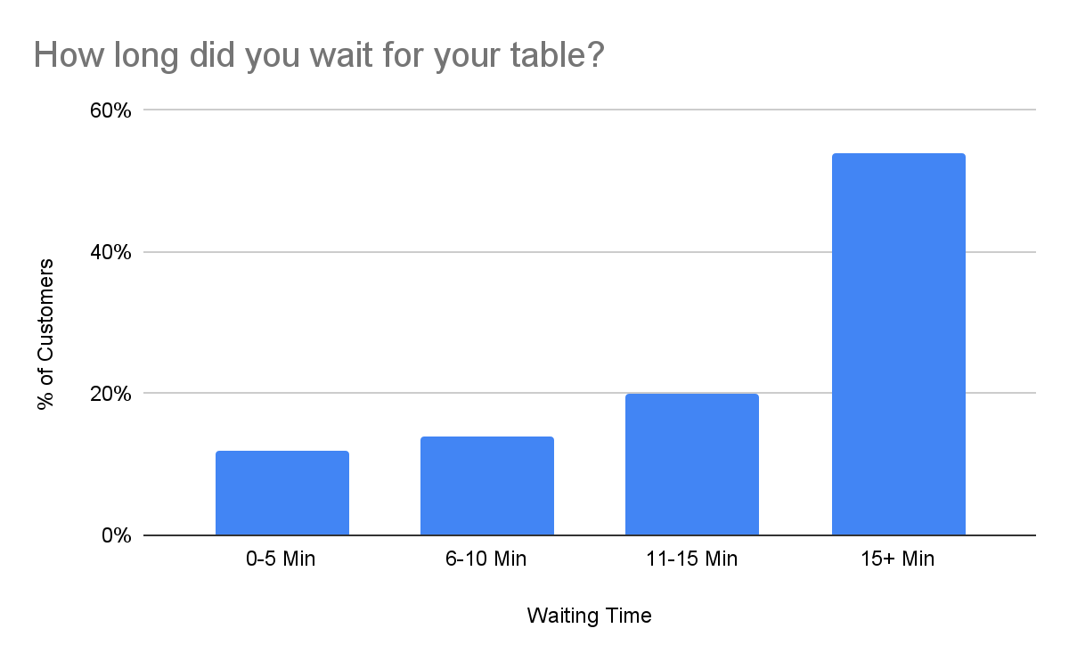
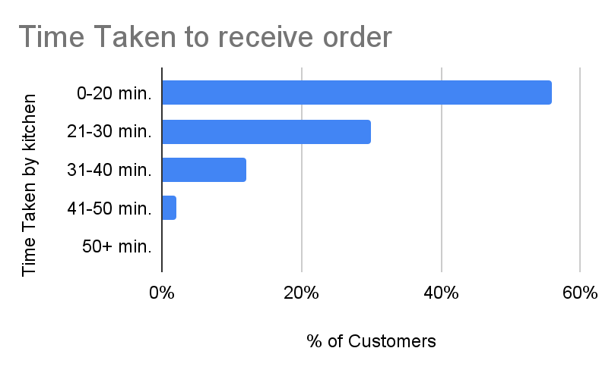
Findings
As we see in this graph, More than 50% of customer have to wait for more than 15 minute to get a table and more than 40% customers get their order after 20 minutes.
This means we have to increase the kitchen staff to prepare food and deliver it to customer more fast.

Slide 6
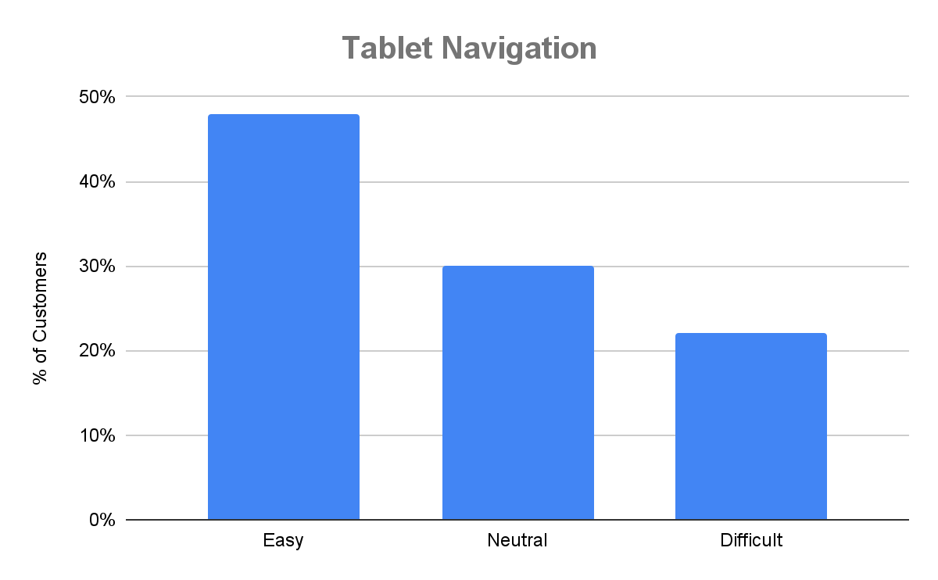
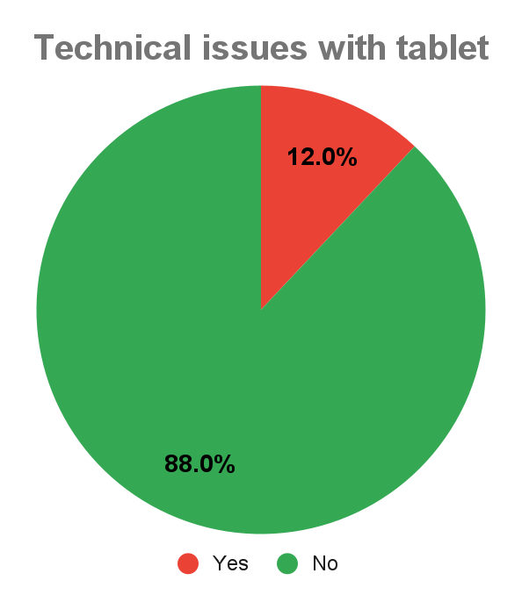
Findings
As we see above, 12% customers still face some issue within the tablet and more than 20% customers still face some difficulty to navigate around the software.
Web studio still make it’s software more easy to use and remove glitch in the next update to provide smooth experience to our customers.

Slide 7
Next Steps
As we successfully run the pilot service with their full potential, we suggest some improvement in our current tasks to provide better experience to our customers :
Small Changes
Focus more on drinks, as we still upscale upto 56% as below the expectations.
24 % customers still not understand the instruction properly as we have to train more to the front-end employees.
18% customers wants the cash option also as they prefer to pay their bills in cash.
Push the customers to subscribe the newsletter and Birthday Club as we see a huge chunks is still left out.
Big Step
Remove any glitches and technical errors from the software by providing updates.
Provide smooth experience to the customer.
Build confidence within customers to multiple orders and check-out through tablets.
Reduce the mix of technology and manpower dependencies.

Slide 8
Next Steps / Future Steps
Future Step / Project
In near future, Sauce & Spoons have to increase their kitchen strength to meet the demand increase by the pilot service introduction.
Currently, the kitchen staff worked at their full potential to meet the demand but it will not work in the future. This lack is affecting the quality of the food the kitchen prepared:
28% customers still get the wrong food or un-prepared food due to shortage of staff in back-end employees. This create chaos and over-burden by the work.
44% customers still wait for more than 20 minutes to get their order on the table, which sometime frustrate the customer.
54% customers still wait for more than 15 minutes to get a table due to slow movement of food between the kitchen and tables.
This is a Huge issue the sauce & spoons has to fix as soon as possible to avoid any problems within their restaurants.

